Slide 1
DIGITAL ALTERNATE WETTING AND DRYING
A Tri-Version Approach to Sustainable Water Management in Agriculture
Name: Arige Srikanth
Your Role: “Digital AWD Intern“
Company/Organization: Dr. Reddy’s Foundation
Date:15-09-2025

Slide 2
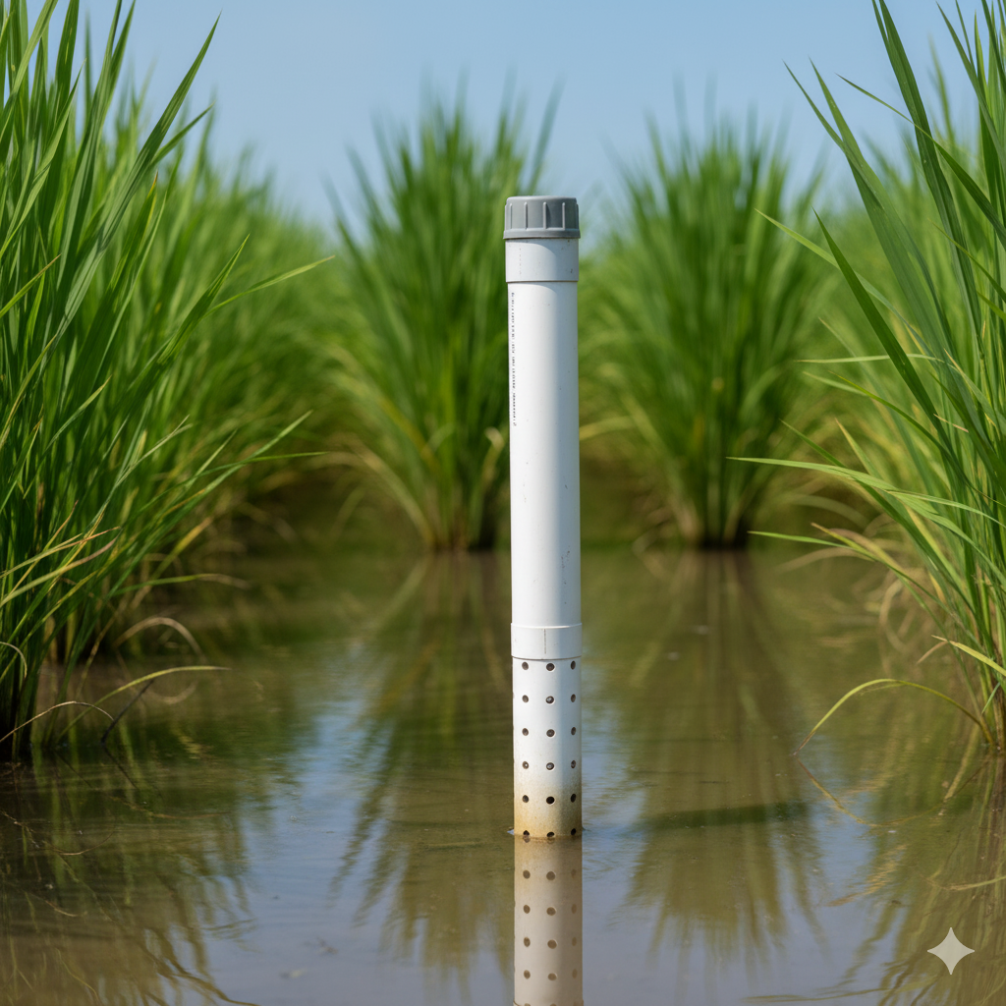
Introduction & Problem Statement
The Challenge: Overcoming Traditional AWD Limitations
Problem Statement:
Start by acknowledging the existence of the traditional (manual) AWD method and highlight its shortcomings, which your project solves The Alternate Wetting and Drying (AWD) technique is a proven method for saving water and reducing greenhouse gas emissions in rice farming However, the traditional, manual implementation of AWD is labor-intensive and often imprecise. Farmers typically use a simple "pani pipe" or tube to check the water level manually, which is time-consuming and can lead to inconsistent results. This manual process makes it difficult for farmers to achieve the precise water levels needed to maximize both water savings and crop yield.it also provides no data for analysis, making it impossible to track the effectiveness of the method or make data-driven decisions for future seasons
The Solution: Digital AWD: Now, introduce your project as the answer to these problems.
We have developed a Digital AWD System that uses modern technology to automate and optimize the AWD process.
By replacing the manual "pani pipe" with an intelligent sensor system, we provide farmers with real-time, accurate data on water levels.
This technology enables data-driven decisions, helps achieve maximum water savings, and provides verifiable data for sustainability initiatives

Slide 3
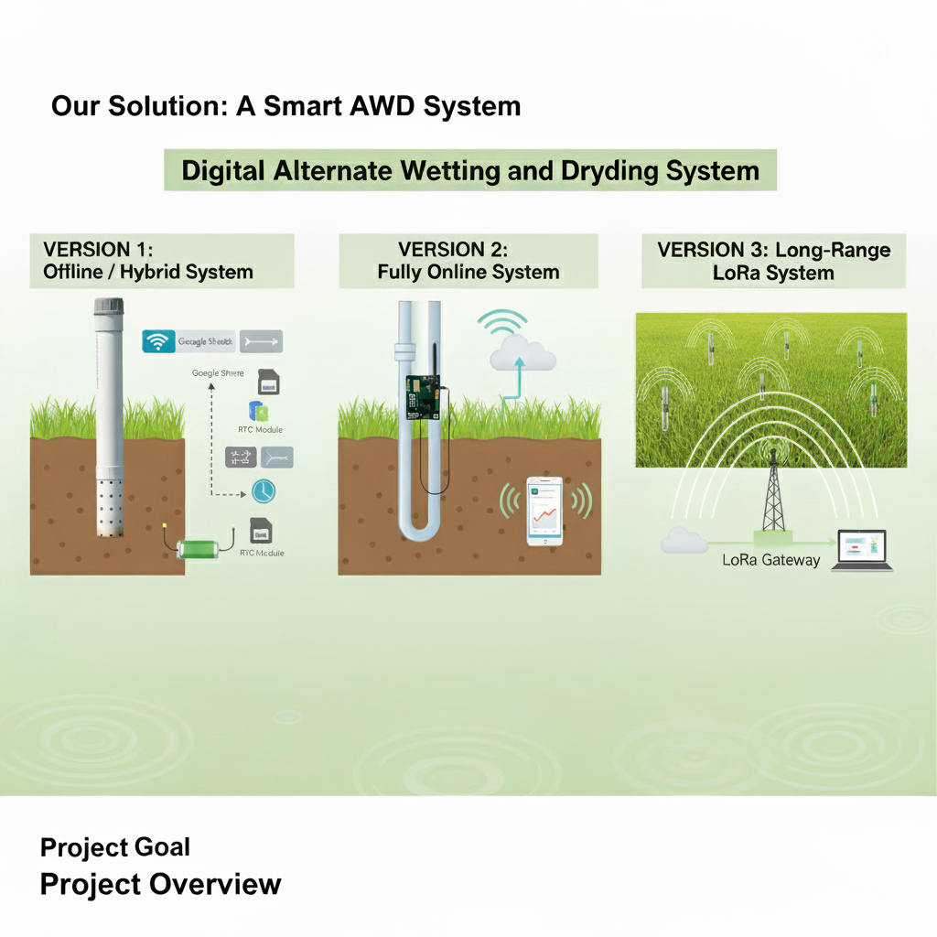
Project Goal & Overview
Goal:
To develop a scalable, cost-effective, and user-friendly IoT-based system that automates the Alternate Wetting and Drying (AWD) process and provides farmers with real-time data to optimize water usage in rice cultivation.
Project Overview:
We have created three different versions of our solution to meet various connectivity and operational needs. These versions range from a completely offline system for areas with no internet access to a long-range wireless solution that can manage multiple fields across a wide area.

Slide 4
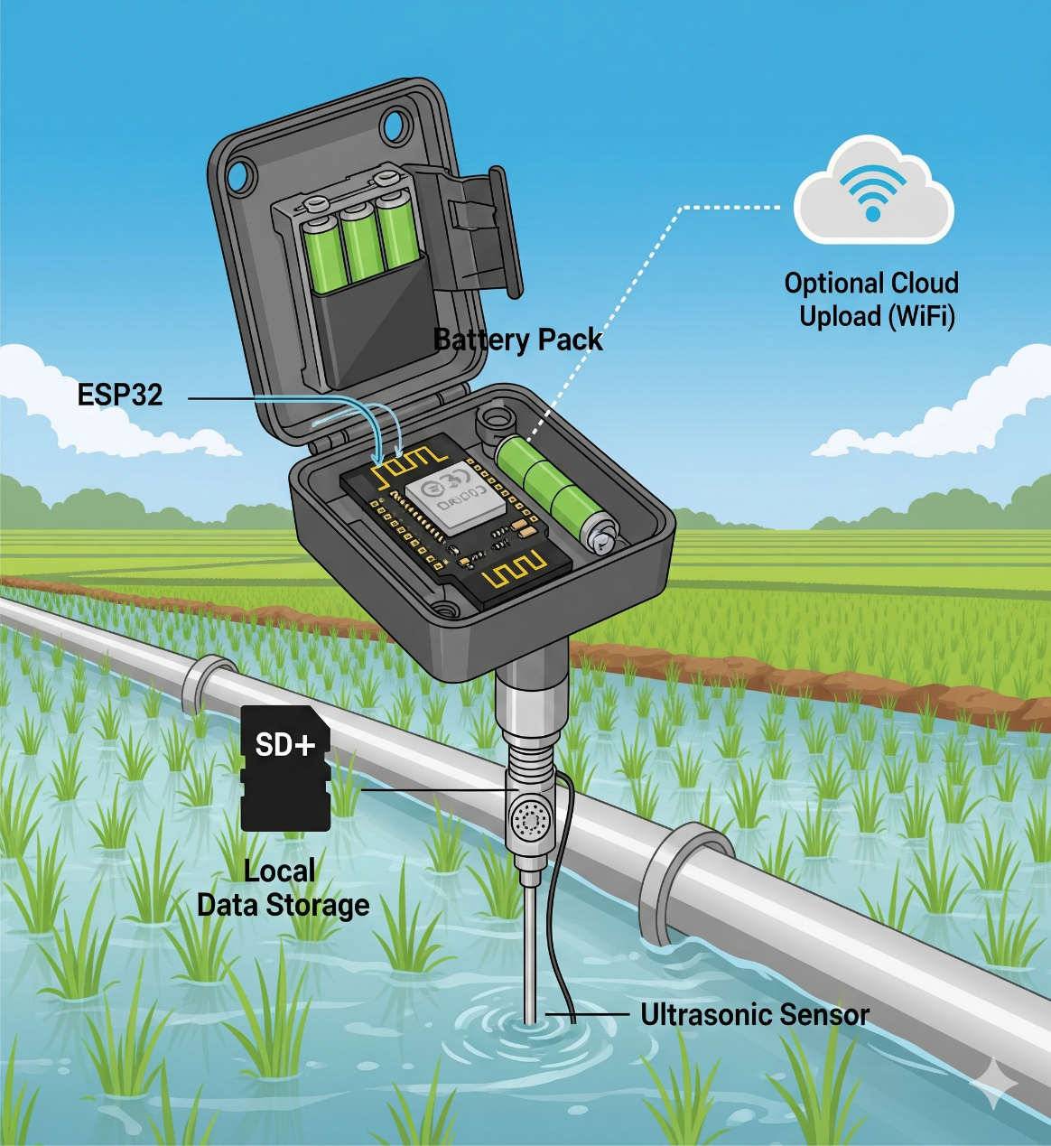
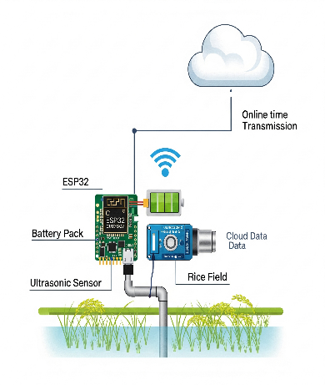
Version 1: The Hybrid Offline System
Hardware Components:
ESP32 & Extension Board: The core processing unit of the system.
AJ-SR04M Ultrasonic Sensor: Precisely measures the water level inside the pipe.
AWD Battery Pack: Provides reliable power for continuous operation.
Solar Panel: A solar panel is used to recharge the battery pack, ensuring the system remains powered.
Data Flow:
With Wi-Fi: Data is wirelessly sent from the ESP32 to a Google Sheet for logging and can be easily monitored on a web page.
Without Wi-Fi: The system seamlessly switches to offline mode, saving all data locally to an SD card.
Key Feature:
An RTC Module (Real-Time Clock) ensures that all data is Time-Stamped accurately, regardless of internet connectivity.

Slide 5
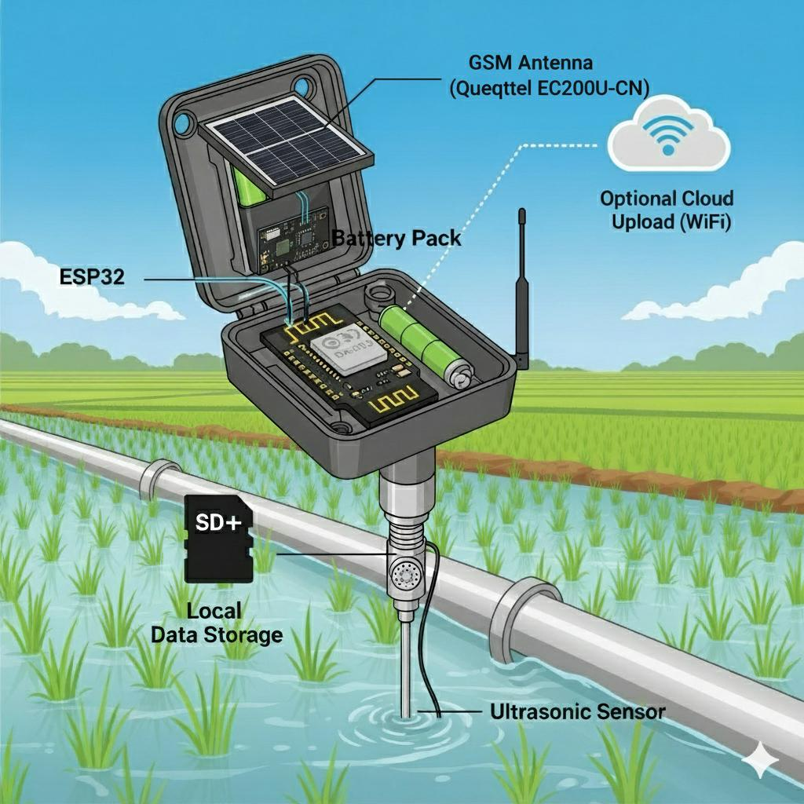
Version 2: The Fully Online System(with GSM Fallback)
Focus:
This version is designed for areas that are primarily online but may experience occasional Wi-Fi disruptions.
Hardware Components:
ESP32 & Extension Board: The central processing unit.
AJ-SR04M Ultrasonic Sensor: Measures the water level.
AWD Battery Pack & Solar Panel: Provides continuous power.
Quectel EC200U-CN GSM Module: A crucial component for ensuring data is never lost.
Data Flow:
With Wi-Fi: Data is streamed in real-time to a cloud server, providing instant access to information.
Without Wi-Fi: The system automatically switches to the Quectel EC200U-CN GSM module. It uses a cellular network to send data via SMS or a data connection to a dedicated server, guaranteeing data delivery even with no Wi-Fi.

Slide 6
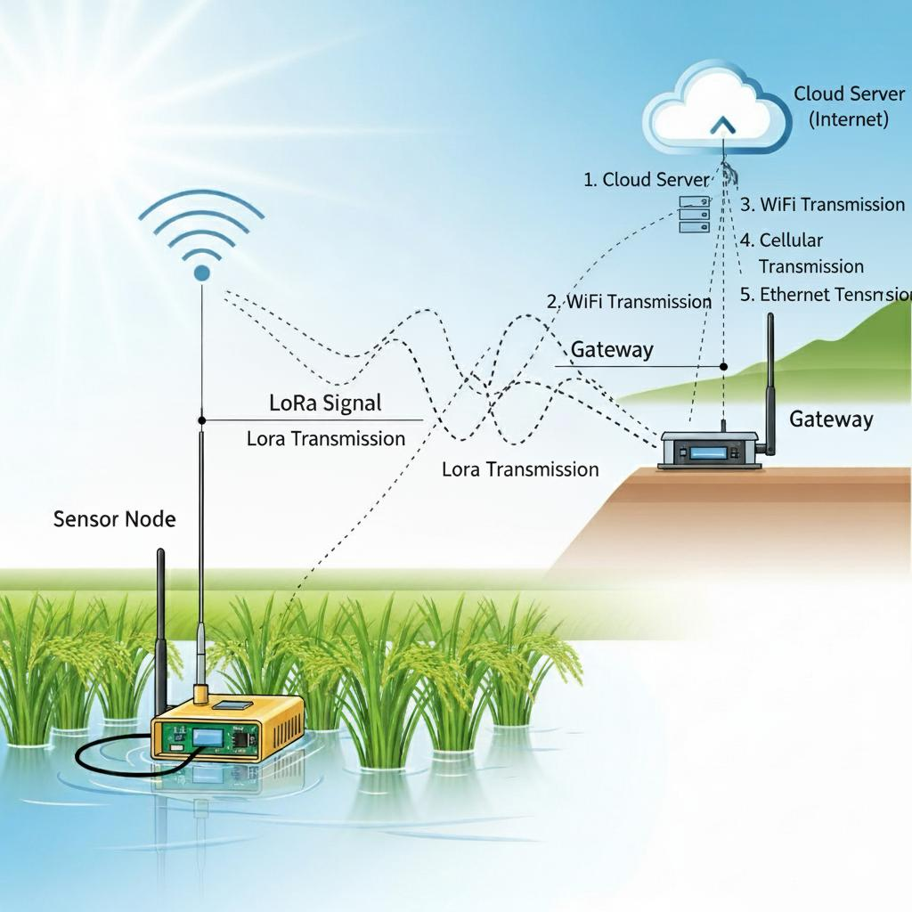
Version 3: The Lo-Ra-Based System
Focus:
This version is built for large fields and remote areas where Wi-Fi or cellular connectivity is unreliable.
Key Technology:
Our solution utilizes Lo-Ra (Long Range) Wireless Technology.
Functionality:
A single Lo-Ra gateway can receive data from multiple sensor nodes spread across a large area. This data is transmitted over long distances with minimal power consumption, making it highly efficient.
Benefit:
This system enables the monitoring of vast agricultural lands with a single central system, which significantly reduces the overall infrastructure costs for farmers.

Slide 7
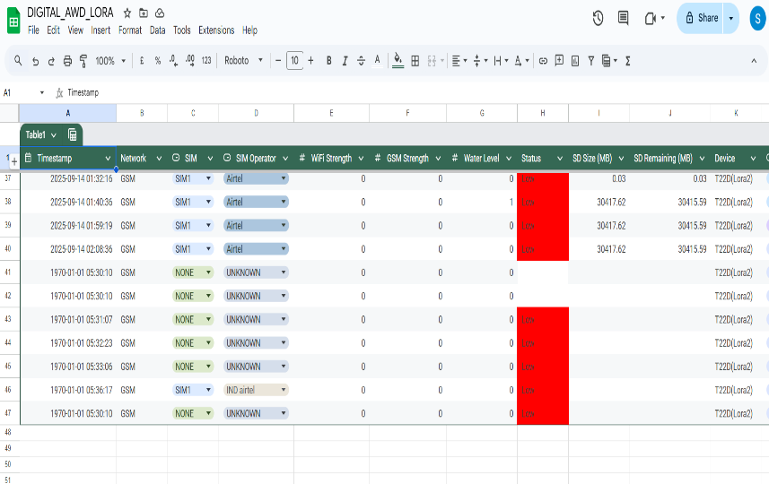
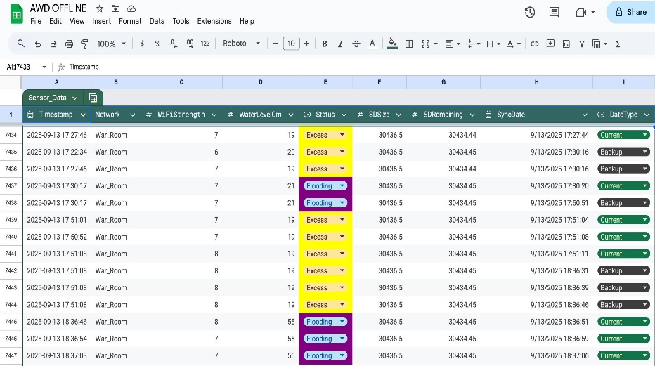
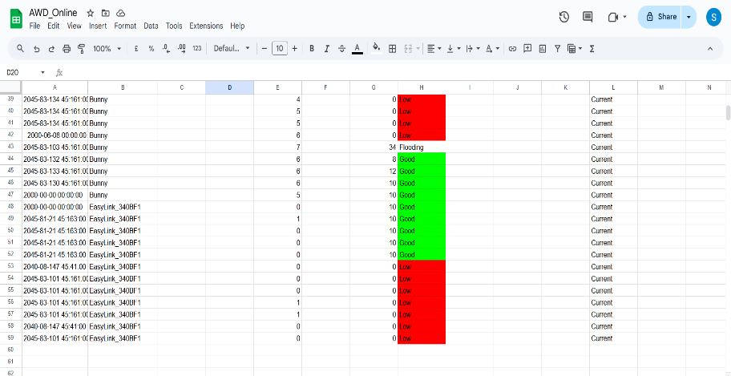
System Outputs & Impact
Version-1
Version-3
Version-2

Slide 8

Go through this web page Or scan the QR For the Web-page
Web-page: https://bunny-lab712.github.io/Digital-AWD/

Slide 9
Conclusion and Future Directions
SUMMARY:
Our three-tiered approach provides a flexible and robust solution for implementing the AWD technique, catering to different farming environments and technological infrastructures.
Next Steps:
On the further development we can use cloud platforms to improve the storage and can use machine learning models for better predictive analysis and can develop an official application so that every farmer can use. Improve the encryption features making data more secured and safe,

Slide 10


